Slide 1

SNAP-Ed Electronic Data System
Kick Off Webinar
September 14, 2017

Slide 2
Agenda-Objectives
Provide overview of SEEDS
Explain how SEEDS is organized
Review functions and how to use SEEDS

Slide 3
Overview
Implementation will begin OCTOBER 1, 2017
    Federal Fiscal Year 2018
1st Monthly Report to be replaced is the one due November 30, 2017

Slide 4

Who Should Access SEEDS?
SEEDS is available to all SNAP-Ed staff
LIAs can define how they would like to define roles within SEEDS
      Note: SEEDS allows multiple users for the same LIA. Changes that are made by one user will affect the entire LIA profile.
      Ex: For example if User A, begins drafting strategy and saves it midway, then User B comes in works on another portion of the strategy and submits, the entire strategy will be submitted for the LIA.

Slide 5
New Terms & Definitions
Term | Definition
Strategy | High level description of evidence-based interventions designed to impact individual’s food or physical activity choices.
Activity | A function of implementing the related strategy.
Track | The specialized path of a strategy that aligns with the Arizona SNAP-Ed Evaluation Framework.
Action | The thing you will do to help achieve the aim of your activity or strategy.
Notes:
These are the core terms
We will provide more information about each of these in the next slides.

Slide 6
How is SEEDS Organized?
The foundation of SEEDS is on the Strategies from FFY2016.
  Direct Education is no longer a stand-alone strategy; instead it is folded under each of the 15 PSE strategies.
  No longer going to be using the numbers for the strategies

Slide 7
Strategies & Activities
Food Systems
Short Name | Description | Activities (Tracks)
Healthy Food Retail | Increase availability of healthy food retail, including mobile vendors, farmers’ markets, corner/country stores, and grocery stores. | New Mobile (Single or Coalition) Existing Mobile (Single or Coalition) New FM or Stand (Single or Coalition) Existing FM or Stand (Single or Coalition) Corner/Country Stores(Single or Coalition) Grocery Stores (Single or Coalition) Growers (Single or Coalition) Food Hub (Single or Coalition) Food Bank (Single or Coalition) Direct Education – Healthy Food Retail (Youth or Adult)
Gardens | Encourage participation in community, home, school, and child care gardens. | New Community Garden New School Garden New Child Care Garden Support Existing Garden Home Garden Training City/County Policy Direct Education – Gardens (Youth or Adult)
Farm to Institution | Start and expand Farm to School, Farm to Child Care, or Farm to Worksite programs. | Garden to Cafeteria (Single or Coalition) Purchasing/ Procurement (Single or Coalition) CSA (Single or Coalition) Direct Education – Farm to Institution(Youth or Adult)
Notes:
We will have a table like this for all the strategies and activities.

Slide 8
Guidance for Track Options
Track | Select this track when you are… | Relevant Strategies
Single Partner | ... working with individual sites or partners | Healthy Food Retail, Farm to Institution, PA Resources
Coalition | … working with a partnership coalition or community coalition (multiple stakeholders). Note: To use the coalition track, the coalition must have at least 5 stakeholders representing distinct community entities and the purpose/activities of the coalition must correspond to the selected strategy. | Healthy Food Retail, Farm to Institution, Active Living Policy, PA Resources
Existing | … working with SFSPs that already exist | Summer Food Service Program
New | … working to create new SFSPs | Summer Food Service Program
Menu Labeling | … working with schools to improve access to nutrition information via menu labeling | Nutrition Information in Schools
Class Curricula | … working with schools to improve access to nutrition information via classroom curricula | Nutrition Information in Schools
Youth | … providing direct education to youth participants. | All Strategies
Adult | … providing direct education to adult participants. | All Strategies
Notes:
Tracks in SEEDS align with the Arizona SNAP-Ed Evaluation Framework

Slide 9
Definitions/Guidance for Action Types
Action Type | Definition
Meeting | A gathering of 2 or more people called to discuss one or more SNAP-Ed strategies. A meeting may or may not include providing technical assistance.
Training | An intentional organized activity designed to build knowledge, skills, or capacity of partner organizations.
Assessment | An evaluation completed using an external instrument or review/report of additional information.
Free Media | Free coverage of SNAP-Ed activities or messages. Media channels include: TV, Radio, Online, Print, or Other.
Paid Media | Paid placement of messages intended to reach the SNAP-Ed target audience. Media channels include: TV, Radio, and Online Ads.
Social Media | Utilization of social media platforms (e.g. Facebook, Twitter, Pinterest) to interact with the SNAP-Ed target audience.
Materials Distribution | Materials shared with partner organizations for the sole purpose of distribution to the SNAP-Ed audience. Activities such as participating in a health fair should be categorized as an event, not material distribution.
Website | Development or maintenance of a website designed to share information with the SNAP-Ed target audience.
Point of Decision Prompts | Motivational signs placed on or near places where decisions are made (e.g. checkout lanes, elevators/stairs, etc.).
Events | Interactions with the SNAP-Ed audience that do not meet the definition of Direct Education. This includes one-time education activities, holding or participating in community events, etc.
Direct Education | Direct Education takes place when a participant is actively engaged in the learning process with an educator and/or interactive media within an evidence-based intervention.
Notes:
Action Types were selected to align with the Arizona SNAP-Ed Evaluation Framework as well as USDA data collection requirements. Below are definitions/guidance for Action Types:

Slide 10
Getting Started
Are special computers or software needed?
  No, SEEDS can be via any computer that has internet access and can accessed via a web browser. It can be accessed via Chrome, Firefox, and Internet Explorer.
      Chrome is recommended

Slide 11
How To Get Access
SEEDS will require authentication via Google.
  This means that Google will manage the emails and passwords for SEEDS.
  Users will be creating and resetting passwords directly through Google.
  To prepare you can register your email with Google.

Slide 12
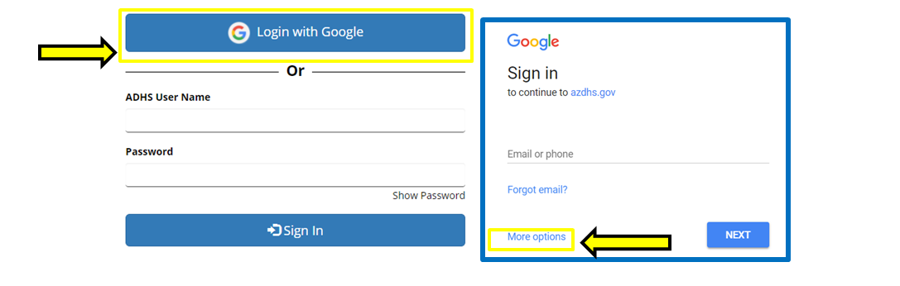
Registering with Google
Notes:
You will be redirected to Microsoft Sign in page
If this is your first time, you will have to “create an account” via Microsoft. This does not mean you are getting a new email, you are registering your current work email with Microsoft to create an account.
You can create a new Microsoft Account by clicking on “Create one!” (Shown above).
Please use your work email for the first box **you do not need to create a new email.**
Once you have completed the registering process with Microsoft, you will be redirected back to the SEEDS website.

Slide 13
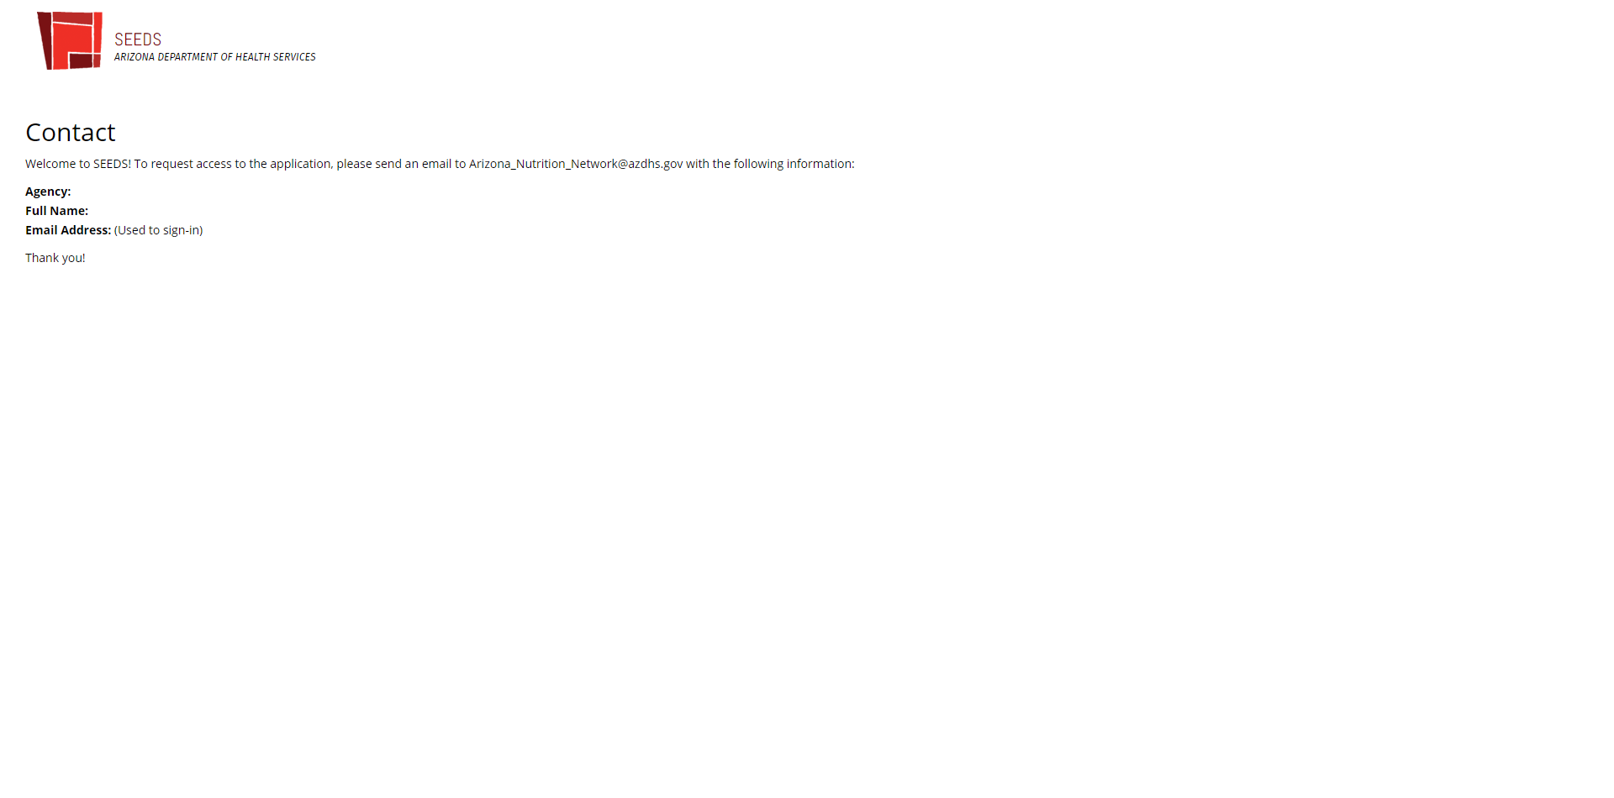
SEEDS Access
Notes:
Once you have completed the registering process with Google, you will be redirected back to the SEEDS website.
If this is your first time logging into SEEDS, you will receive the message instructing you to:
Please email: Arizona_Nutrition_Network@azdhs.gov and provide:
Local Implementing Agency
Full Name
Email Address
You will be granted access by the State Implementation Team and should hear back within 3-5 business days.

Slide 14
Flow of Functions
I. Selecting Strategies
II. Selecting Activities/Tracks
IV. Acknowlegding Indicators & Submitting Strategy for approval
V. Creating & Saving Actions
III. Selecting Community
Approval

Slide 15
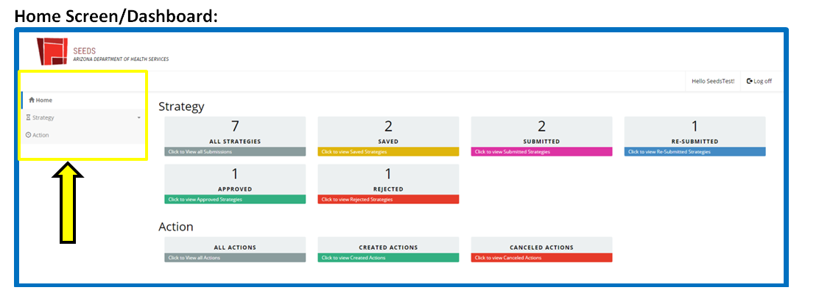
User Guide- Navigating
Notes:
Once you log in, you will land on the “Home” screen, which is also your dashboard. This will show the number of strategies in each of the different statuses. This page will also allow you to view and navigate between all your actions.
The yellow box shows the navigation bar which will be on all screens. This will allow you to navigate between the different screens. (Please note it is recommended that you use the navigation bar versus the back button on your browser.)

Slide 16
Functionality
The system builds off each other.
You must complete each step before the next (and vice versa when removing).
Example:
  If you do not select a strategy you cannot select or connect to activities/tracks.
  If you would like to remove a strategy you must remove all activities/tracks first.

Slide 17
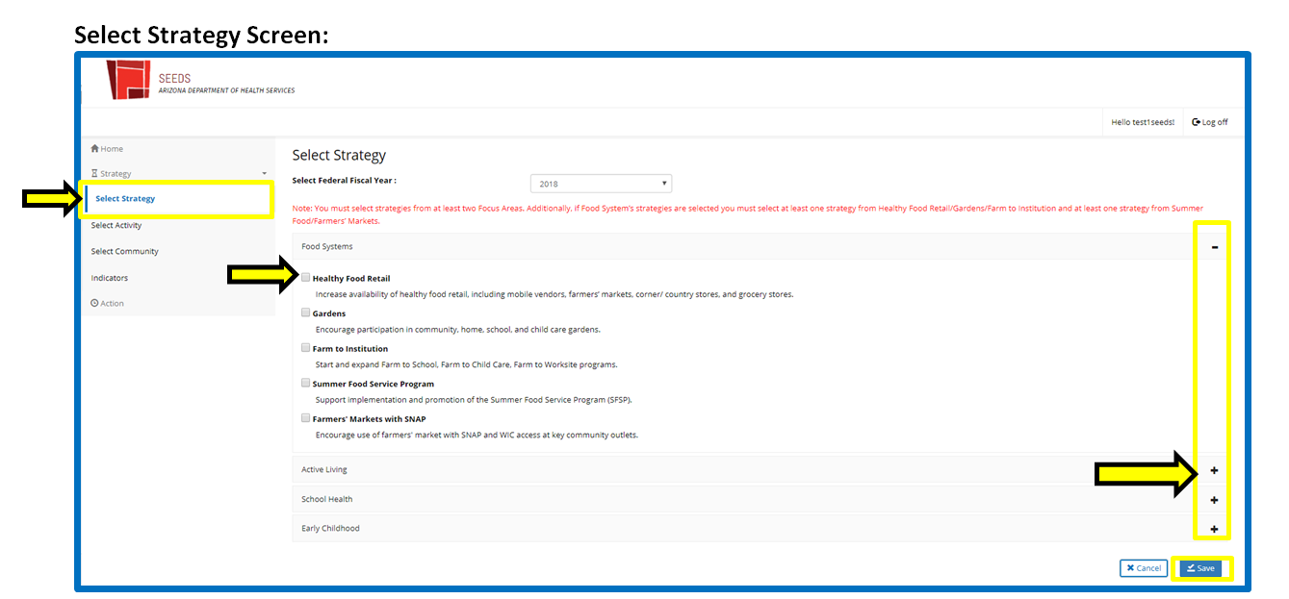
I. Select Strategy

Slide 18
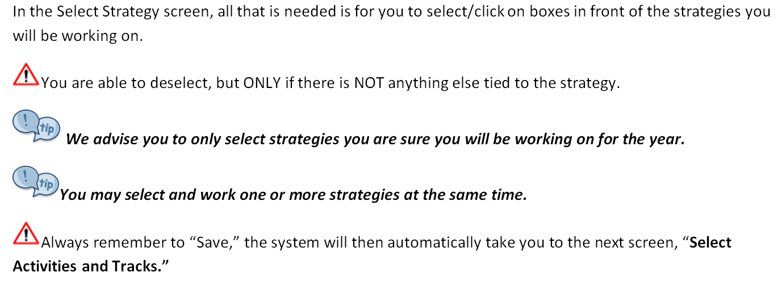
I. Select Strategy (cont.)

Slide 19
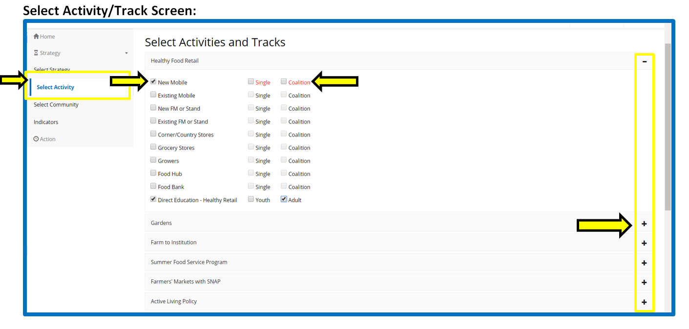
II. Select Activity/Track

Slide 20
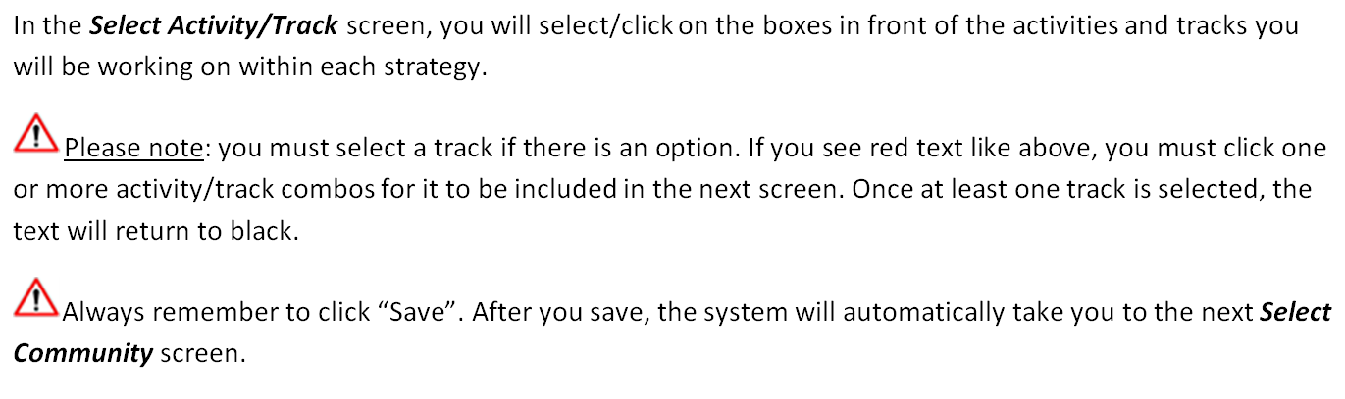
II. Select Activity/Track (cont.)

Slide 21
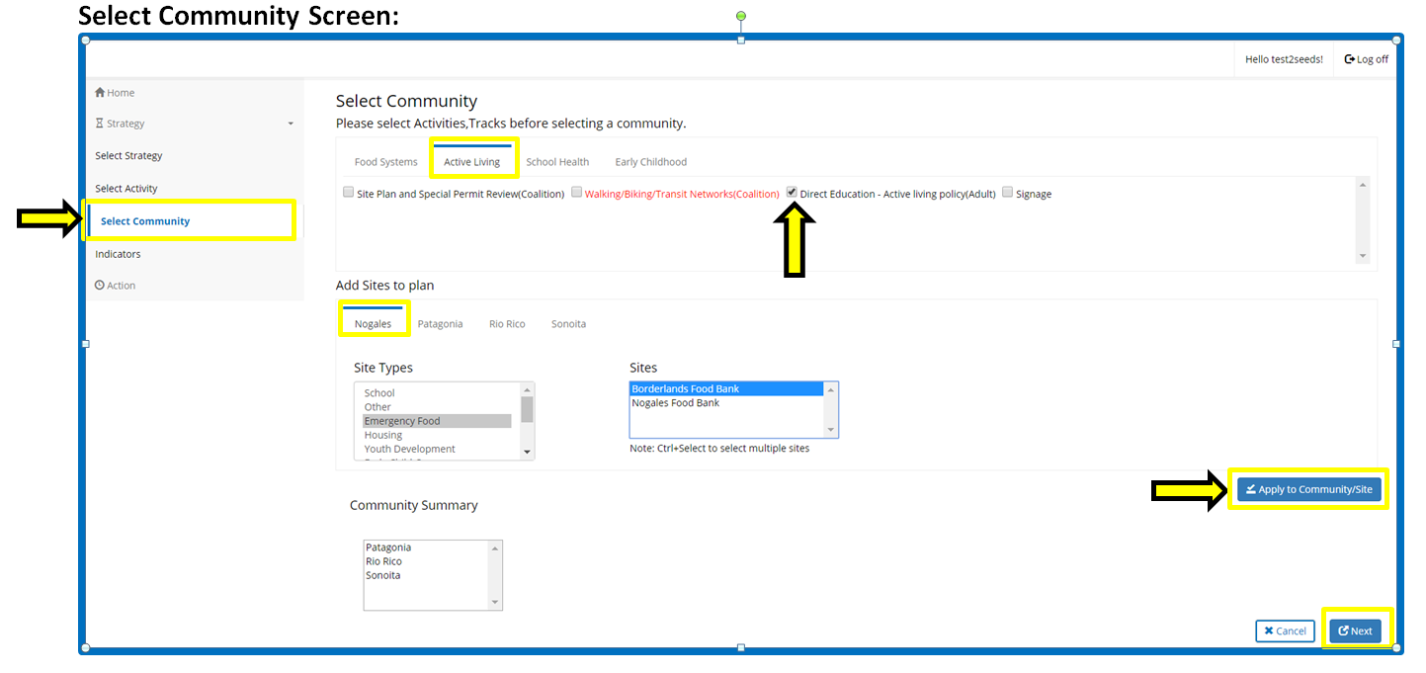
III. Select Community
Notes:
The goal of the Select Community screen is to connect activities/tracks (within the Focus Areas) and assign each to a community or communities. The Select Community screen also will allow you assign a site(s) within the community (but it is not required.)
Only Focus Areas where both strategies AND activities/tracks have been selected will appear.
You must click the Focus Area name to view the different activities/tracks with in each (above Active Living is selected so all activities/tracks that have been selected on the Select Activity/Track screen within Active Living are shown).
You can select multiple activities/tracks in different Focus Areas simultaneously when adding to communities.
You can select multiple sites but not from multiple communities .
Why not? this logic doesn’t make sense since the focus area format is similar.
Because of the multi-level filters.. (1) community, (2) site type

Slide 22

Approaches
  We advise you to approach the Select Community screen in one of the two ways below:
1 | By Site: | Select all activities/tracks in all Focus Areas for each site and then apply. This will reduce the overall number of clicks needed.
2 | By Activity: | Select each activity, then apply to all sites within each community. This works best when multiple staff will be completing data entry or for teams organized by strategy or subject matter experts.

Slide 23
III. Select Community (again)
Notes:
Please note: you must assign activities/tracks to at least one community. If you see red text like above, it is an indication that this activity has not been assigned. When it has been assigned, it will return to black text.
Please note: If you do not click on “apply to community/site” all the selections you have made will NOT save and your activities/tracks will not have communities!

Slide 24
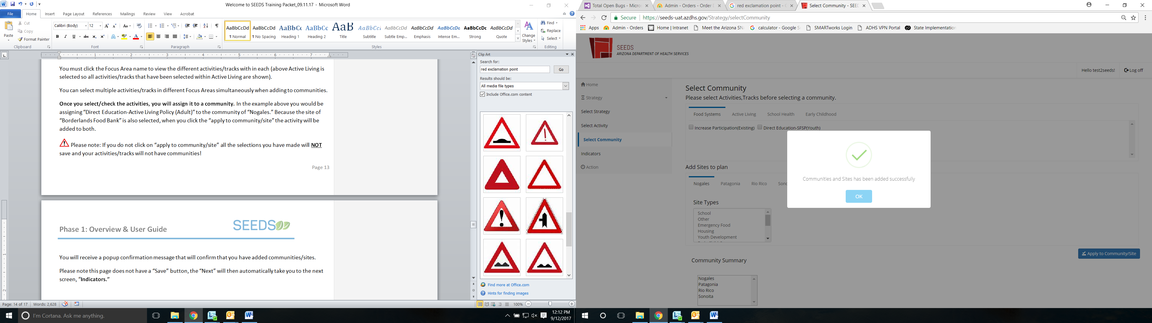
Confirmation of Community/Sites
Notes:
You will receive a popup confirmation message (above) that will confirm that you have added communities/sites.
Please note: the Select Community Page does not have a “Save” button, if you do not receive the confirmation above, your work will NOT be saved.

Slide 25
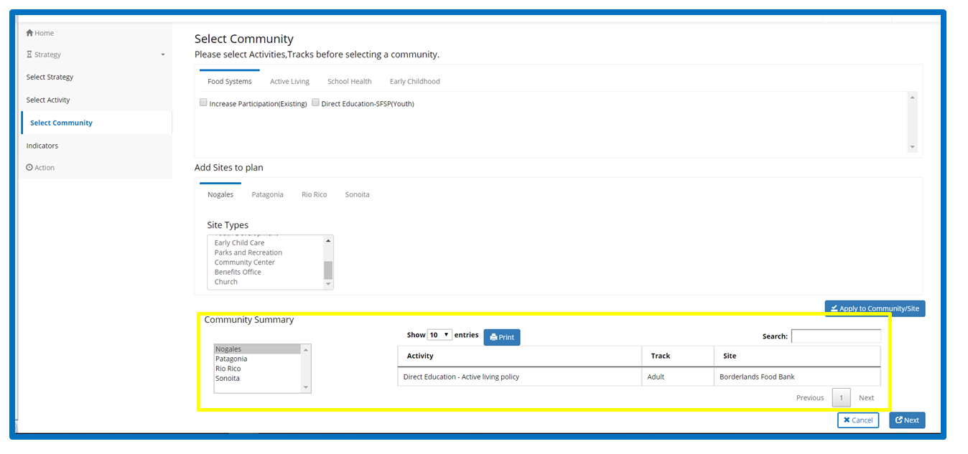
Community Summary Section
Notes:
The “Community Summary” section shows a summary of activities assigned and organized by community. It will display all activities/track for each community.
You are able to search and sort within the Community Summary.
You can click on the headers/banners of Activity, Track or Site, and it will sort by each in ascending or descending order.
There is a print option available. This will extract the community summary shown at the time.
The “Next” button will then automatically take you to the Indicators screen.

Slide 26
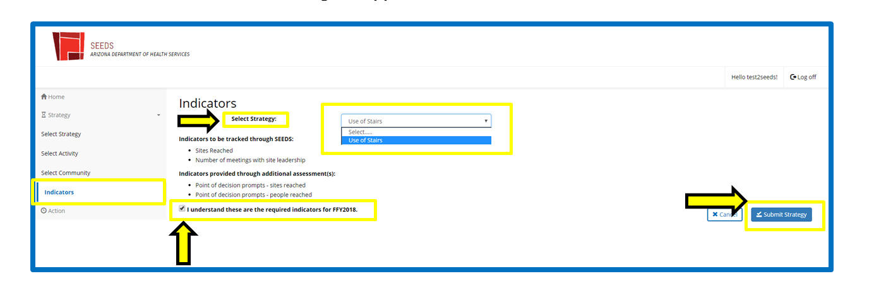
IV. Indicators & Submitting for Approval
Notes:
After you have: 1) Selected Strategy, 2) Selected Activity/Track, 3) Selected Community, you are ready to submit for approval.
All submissions will start in the Indicators screen. The screen will be blank until you select a strategy from the dropdown. Only strategies that have been tied to activities/tracks and communities will be available in the dropdown.
Here the strategy Use of Stairs has been selected, the indicators for this strategy popup and you will have to click the box “I understand these are the required indicators for FFY2018.” Once you have acknowledged, then you are able to click on the “Submit Strategy” button.
This will then be sent to the State Implementation Team and they will either “approve” or “reject,” with feedback for resubmission.
The status of the strategy will change to “Submitted.”

Slide 27
Strategy Statuses
Saved | Once you select and save a strategy it will be in Saved status. The strategy will remain in Saved status until submitted for review by the SIT.
Submitted | Once all the steps are completed and you acknowledge indicators it will be in Submitted status. The SIT will be notified this strategy is ready for review.
Approved | Once the SIT approves your strategy it will be in Approved status. * This will be for both 1st submissions and resubmissions.
Rejected | If the SIT rejects, your strategy, the SIT will provide instructions for revisions. It will remain in Rejected status until it is corrected and resubmitted.
Resubmitted | A strategy will be in Resubmitted status if a strategy is edited and submitted again after approval or rejection by SIT.
Notes:
These will be how your strategies are categorized in the home/dashboard screen.

Slide 28
V. Editing Strategies, Activities/Tracks, & Communities
There are two main types of edits
  Adding: will always be done in the corresponding screen. You are able to select/click Strategies and Activities/Tracks in the corresponding screens any time. If the strategy is in approved or rejected status, you will need to resubmit.
  Deleting: will be done via the View Strategy Detail screen when communities are tied to it. Otherwise (given there is nothing tied to it) you can deselect in the corresponding screen.
Notes:
You are able to edit strategies throughout the process and in any status.

Slide 29
Adding

Slide 30
Deleting (Step 1)

Slide 31
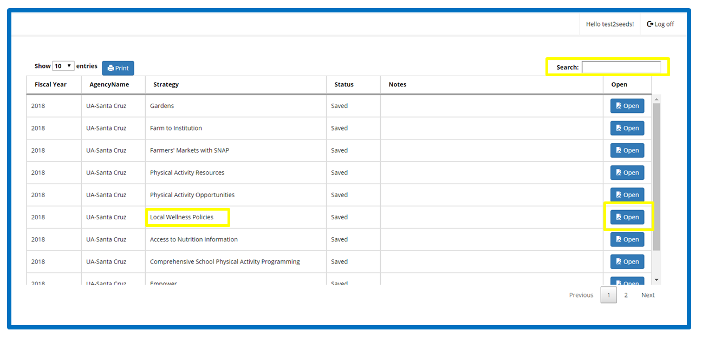
Deleting (Step 2)

Slide 32
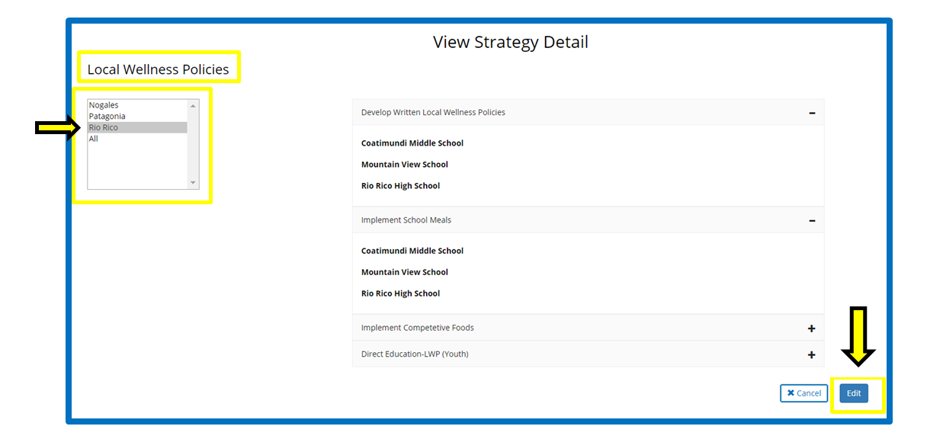
Deleting (Step 3)

Slide 33
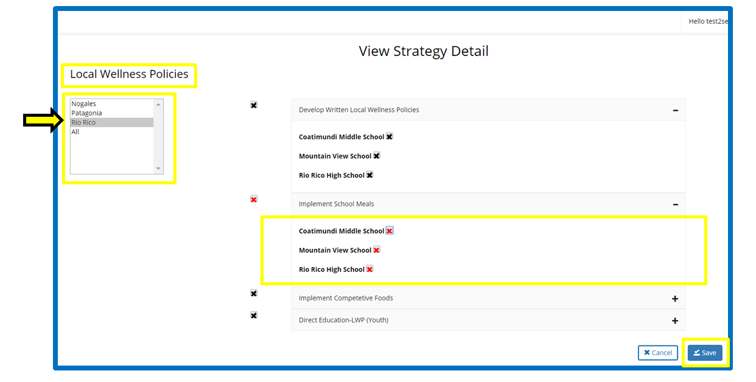
Deleting (Step 4)

Slide 34
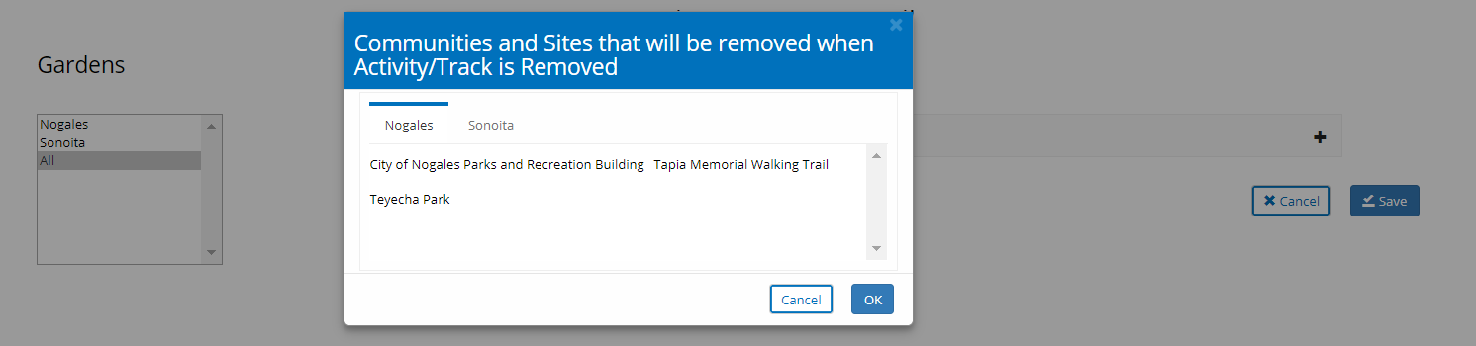
Deleting Activities
If an Activity/Track has more than 1 community or site, when you delete. It will be deleted from ALL communities and sites.

Slide 35
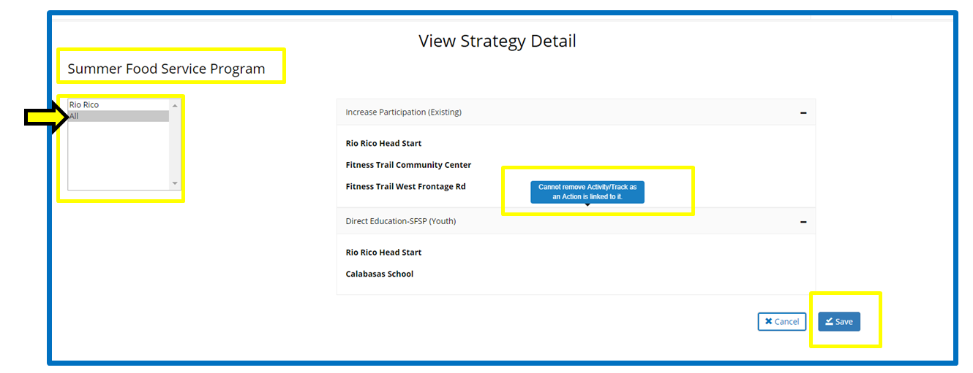
Deleting (when linked)
Notes:
Not possible!

Slide 36
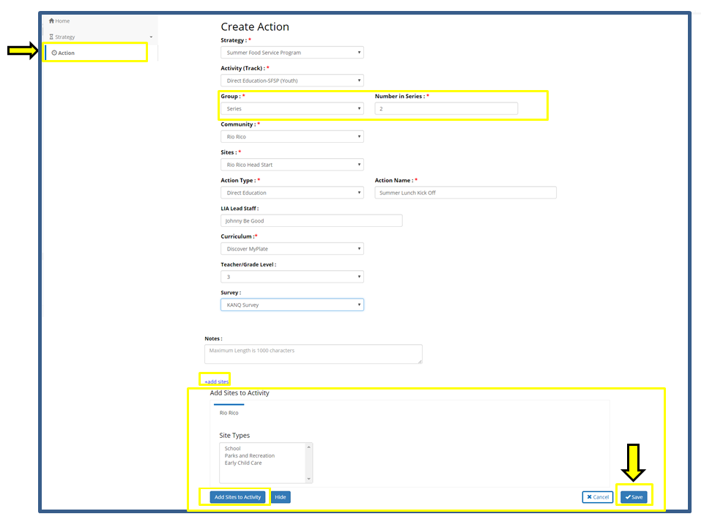
VI. Creating Actions

Slide 37
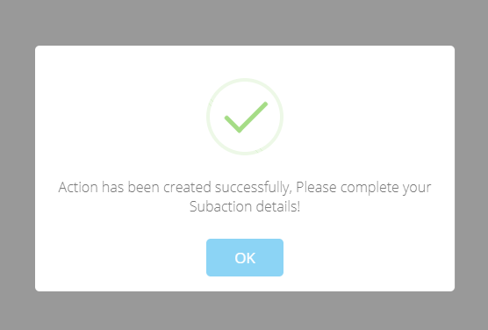
Creating Sub-Actions
When you select a series, it will ask for number of series. This will automatically create sub-actions.

Slide 38
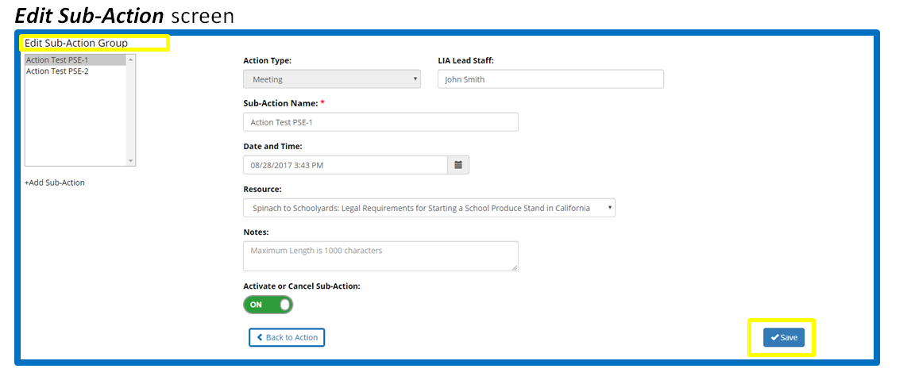
Sub-Action Screen

Slide 39
VII. Editing Actions & Sub-Actions
You will be automatically taken to the Edit Action or Edit Sub-Action screen, once you save when in Creating Action screen.
But if you would like to view your action, you are able to access it via the Home/Dashboard screen.
Notes:
To access the Edit Action or Edit Sub-Action screen, you will go into the Home Screen→select the Action by clicking “All Actions”→search and find your Action →click name in blue text.
Sub-Actions will be listed under the parent action.

Slide 40
Editing Action/Sub-Action (Step 1)

Slide 41
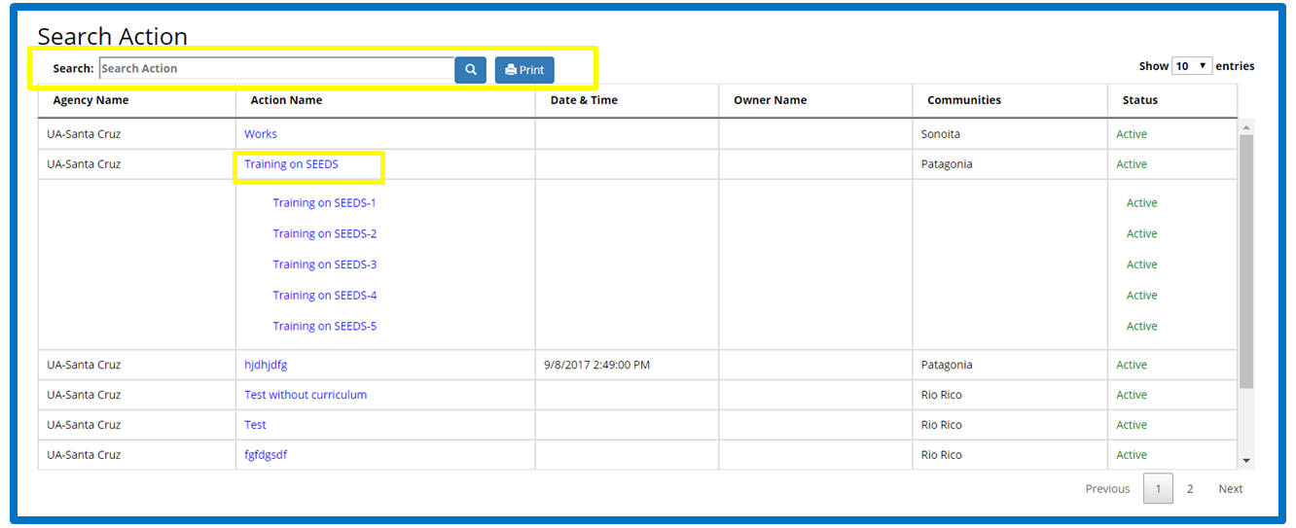
Editing Action/Sub-Action (Step 2)

Slide 42
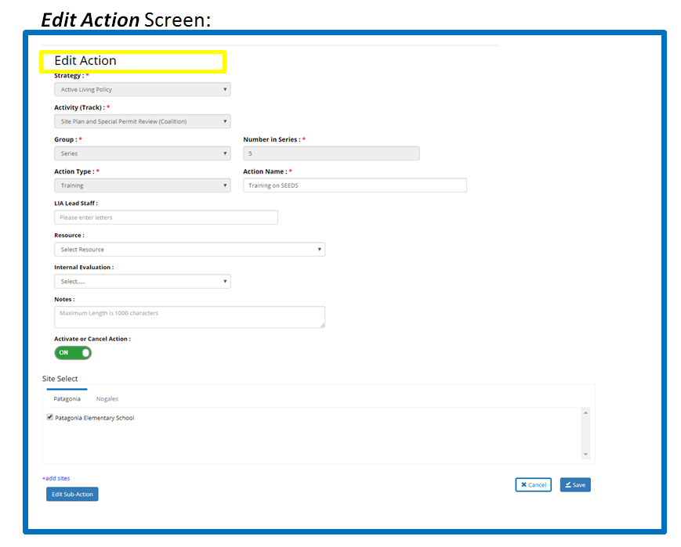
Editing Action/Sub-Action (Step 3)

Slide 43
VIII. Logging Off

Slide 44
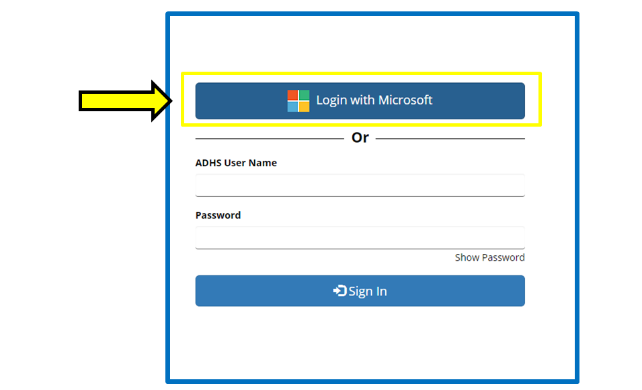
VIII. Logging Off
Notes:
Because of the authentication with Microsoft, your user name and password will continue to be stored/logged in, even if you click on the “Log off” button on a screen; this means you will continue to be logged in until you close your Internet Browser.

Slide 45
Questions???

Slide 46
Next Steps & Timeline
Phase 2 for SEEDS is expected to be released in late October 2017.
Phase 2 will be Action data, which will replace the Monthly Report data elements.

Slide 47
Open House TA available Pre-P&P Training:
Northern AZ: Flagstaff
  Monday, October 2, 2017 12pm-5pm:
Central AZ: Phoenix/Tempe
  Tuesday, Oct. 3, 2017 12pm-5pm
Southern AZ: Tucson
  Wednesday, Oct. 4, 2017 12pm-5pm

Slide 48
Future Questions
Please feel free to reach out to us with any questions.
For SEEDS specific information: contact Edith Di Santo:, edith.disanto@azdhs.gov

