Slide 1

SNAP-Ed Electronic Data System
Phase 2 Release 1

Slide 2
Agenda-Objectives
Provide Overview of Phase 2, Release 1
Explain “Tracking Data”
Review screens and capabilities
Walk through Scenarios together

Slide 3
Overview
Phase 2, Release 1
  Was launched Monday, Nov. 20th ☺
Data entered here will replace Monthly Reports for all actions beginning Oct. 1, 2017

Slide 4
What will change?
Nothing will change for the work you already completed in SEEDS with your Strategies, Activities, and Communities
We will expand on your previous work in “Create Action” by entering “Tracking Data” for each Action

Slide 5

Will I need to submit a report?
No, there will no longer be an Excel spreadsheet that will need to be sent to the State Implementation Team each month.

Slide 6
When do I enter Tracking Data?
All Actions will have a “trigger” date
“Trigger” date will be based on your Action Type.
Trigger Date | Action Types
Action Date | Meeting, Training, Assessment, Free Media, Materials Distribution, Event, Direct Education
End Date | Paid Media, Social Media, Point of Decision Prompts, Website
Notes:
Those actions that have an end date, the trigger date will be the end date, if not it will be the action date.

Slide 7
What does the “trigger” date do?
Enables Tracking Data tab
2) Locks the date fields (cannot be change after trigger date has passed and prevents canceling actions)
3) Changes status from Created to Pending Data

Slide 8

Trigger Date
Primary purpose is to enable the Tracking Data tab for your action.
You will NOT be able to enter Tracking Data until the trigger date is in the PAST!
If the Tracking Data tab is not enabled please check the Info. tab to make sure that the trigger date has passed or the date is not missing.

Slide 9
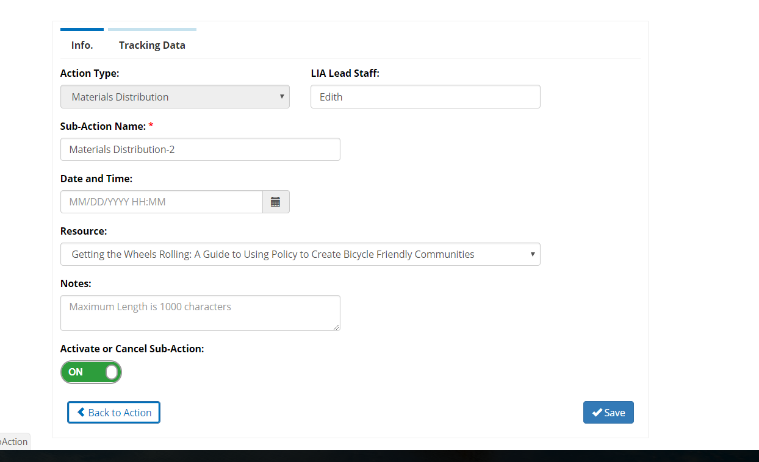

Tracking Data not Enabled

Slide 10
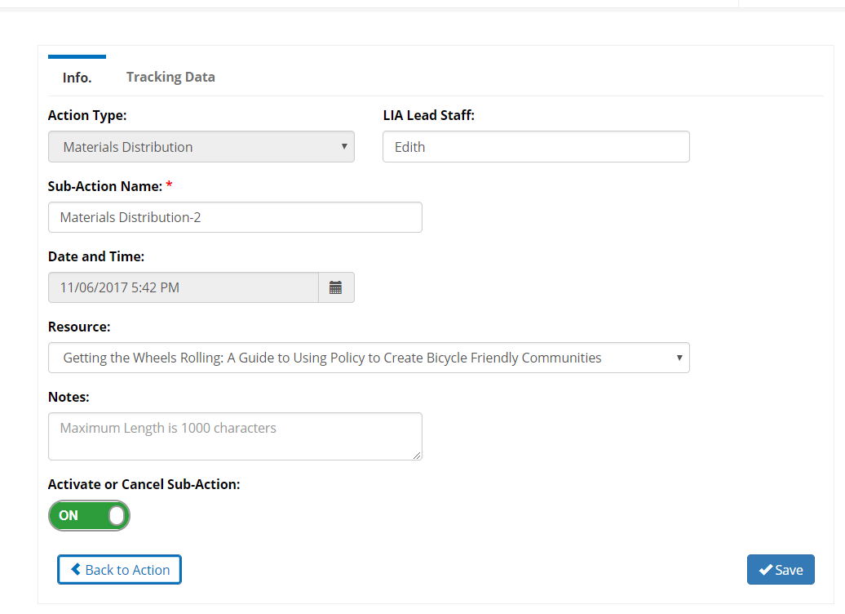

Locked Date Fields
Notes:
Since the date of 11/06/17 is in the past, you will not be able to change the date or cancel the action.
QUESTIONS?

Slide 11
Action Status Table
Created | The action has been created, but it is before the Trigger Date or date field is blank.
Pending Data | The action has been created, and the Trigger Date has passed. When the Trigger Date has passed, the status will automatically change to “Pending Data.”
Saved | When information has been entered and saved to Tracking Data but not marked as complete.
Completed | When all information has been entered and it is marked as complete. (no other changes can be made after marked as completed)
Canceled | When an action and all sub-actions have been inactivated.

Slide 12
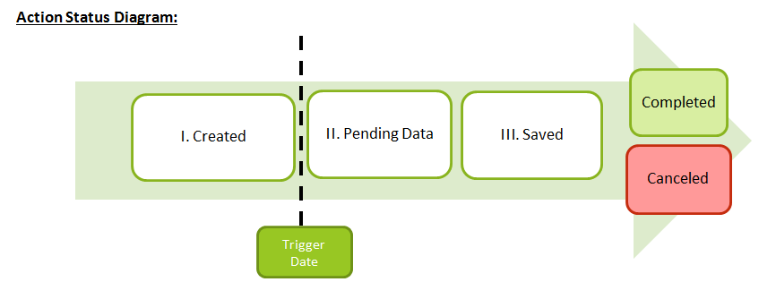
Action Flow

Slide 13

Pops will provide guidance
Please read the all the pop ups because they will provide details on:
  what will happen
  what is needed if you are not able to complete an action.
Notes:
Popups will only be enabled when completing an action.

Slide 14
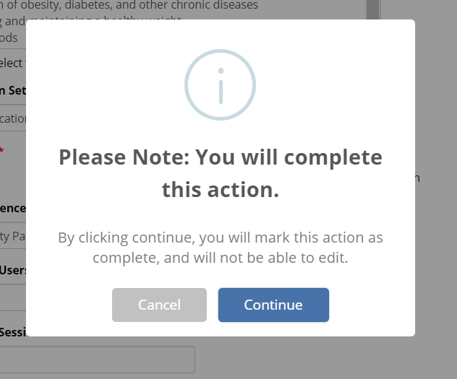
Completed Status Notice

Slide 15
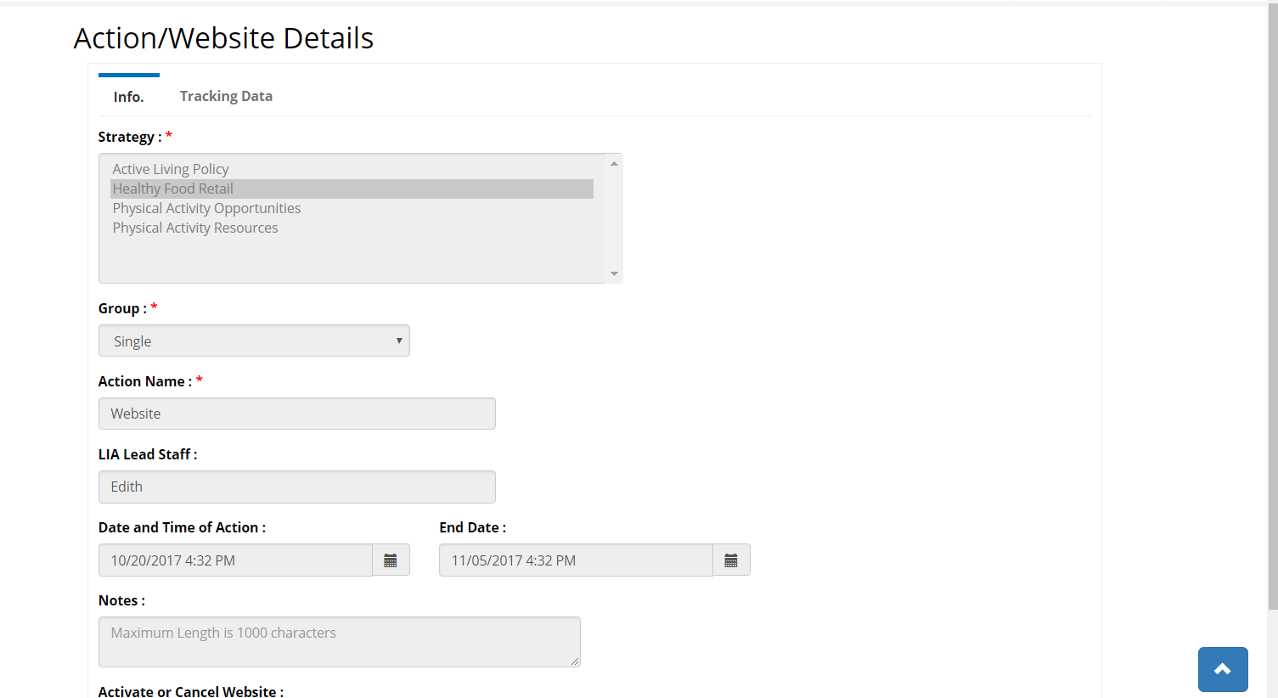
Completed Status
Notes:
Will not be able to edit

Slide 16
Is there a due date?
Deadlines will be incorporated automatically into SEEDS- but they will NOT be enforced during this launch
Will be enforced beginning April 1, 2018
Notes:
This matches the notion that each action will be logged individually and there will not be one report complied on a monthly basis.

Slide 17
Future Deadlines
You will have 30 days from trigger date to complete an action
Deadlines will not be a single date on the calendar
Due date will be ongoing in relation to trigger date of the Action

Slide 18
Future Timelines
*Must be within current Federal Fiscal Year Oct. 01 –Sept. 30
Creating Actions in the future can be done without restriction *
30 days to enter tracking data
Trigger Date
Creating Actions in the past MUST be done within 30 days of today’s date and the trigger date

Slide 19
How is Phase 2 organized?
For each Action, you will need to enter tracking data and mark as complete.
The data fields required will be different based on the selected “Action Type.”
We will provide guidance for the required fields.

Slide 20
Definitions/Guidance for Action Types
Action Type | Definition
Meeting | A gathering of 2 or more people called to discuss one or more SNAP-Ed strategies. A meeting may or may not include providing technical assistance.
Training | An intentional organized activity designed to build knowledge, skills, or capacity of partner organizations.
Assessment | An evaluation completed using an external instrument or review/report of additional information.
Free Media | Free coverage of SNAP-Ed activities or messages. Media channels include: TV, Radio, Online, Print, or Other.
Paid Media | Paid placement of messages intended to reach the SNAP-Ed target audience. Media channels include: TV, Radio, and Online Ads.
Social Media | Utilization of social media platforms (e.g. Facebook, Twitter, Pinterest) to interact with the SNAP-Ed target audience.
Materials Distribution | Materials shared with partner organizations for the sole purpose of distribution to the SNAP-Ed audience. Activities such as participating in a health fair should be categorized as an event, not material distribution.
Website | Development or maintenance of a website designed to share information with the SNAP-Ed target audience.
Point of Decision Prompts | Motivational signs placed on or near places where decisions are made (e.g. checkout lanes, elevators/stairs, etc.).
Events | Interactions with the SNAP-Ed audience that do not meet the definition of Direct Education. This includes one-time education activities, holding or participating in community events, etc.
Direct Education | Direct Education takes place when a participant is actively engaged in the learning process with an educator and/or interactive media within an evidence-based intervention.
Notes:
Action Types were selected to align with the Arizona SNAP-Ed Evaluation Framework as well as USDA data collection requirements. Below are definitions/guidance for Action Types:

Slide 21

All* fields become required
In the “Create Action” screen, all fields were not required to save the action, but in order to mark an action as “Complete” you must enter all* the fields on both the Info. and Tracking Data tabs.
Essentially all fields become required. (only the notes fields are optional)
Please note: Some fields may not have the *
Notes:
and curriculum* (if not DE)

Slide 22
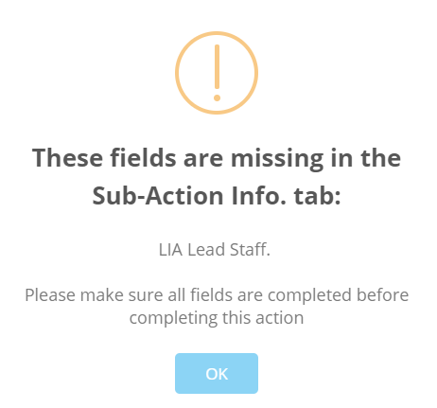
Example of Pop Up Missing Data

Slide 23
Tracking Data Fields
Specific to the Action Type
Some fields are required for all (or most) Action Types
  Intervention Setting
  Intervention Topic
  Audience Type
Options are based on the USDA EARS Form

Slide 24
Intervention Topic
Select as many as appropriate
Use your ctrl button and mouse to select multiple topics

Slide 25
Intervention Topics-Dropdown
Active commuting
Breastfeeding
Dairy
Family meals/family-style meal service
Fiber-rich foods
Food preparation/cooking and food safety
Food shopping and resource management
Fruits and vegetables
Healthy fats and oils
Limiting added sugars
Limiting saturated fats
Limiting sodium
My Plate food groups and portions for a healthy eating pattern
Participation in sports and recreational activities
Prevention of obesity, diabetes, and other chronic diseases
Promoting and maintaining a healthy weight
Protein foods
Reducing sedentary activities and screen time
Water
Whole grains

Slide 26
Intervention Setting
ONLY ONE is allowed
Specific to the strategy and activity of the intervention.
Although there may be more than one option that fits, you should select the one that is most relevant or that is the major intent of the intervention.

Slide 27
Intervention Setting (scenario)
In theory, a site could be “XYZ school,” but depending on the intervention you are reporting on, it will have a different Intervention Setting which will be matched and based on the strategy and activity.

Slide 28
Intervention Setting (scenario) cont.
For example: “XYZ school” could be the site for a new school garden in the Garden strategy, and the Intervention Setting would be Gardens (community/school/childcare).
In another instance, “XYZ school” could be the site for Summer Food Service Program, and the Intervention Setting would be USDA Summer Meals Sites.

Slide 29
Intervention Setting Dropdowns
Adult education, job training, TANF, and veteran services sites
Before- and after-school programs
Bicycle and walking paths
Community and recreation centers
Congregate meal sites/senior nutrition centers
Early care and education facilities
Emergency shelters and temporary housing sites
Extension offices
Faith-based centers/places of worship
Family resource centers
Farmers markets
FDPIR distribution sites
Food assistance sites, food banks, and food pantries
Gardens (community/school/childcare)
Group living arrangements/residential treatment centers
Health care clinics and hospitals
Indian reservations
Individual homes or public housing sites
Large food stores and retailers (4+registers)
Libraries
Military bases
Mobile education sites
Mobile vending/food trucks
Parks and open spaces
Schools (colleges and universities)
Schools (K-12, elementary, middle, and high)
Small food stores (≤3 registers)
SNAP offices
Soup kitchens
State/County fairgrounds
Transit
USDA Summer Meals sites
WIC clinics
Worksites with low-wage workers

Slide 30
Audience Type
Dropdowns will be adapted by strategy.
Examples include:
  Site/Partner Staff
  Youth/Parents/Community Advocates
  Food Service Staff
  Growers/Producers
  Board Members/Administrators
  Local Government

Slide 31
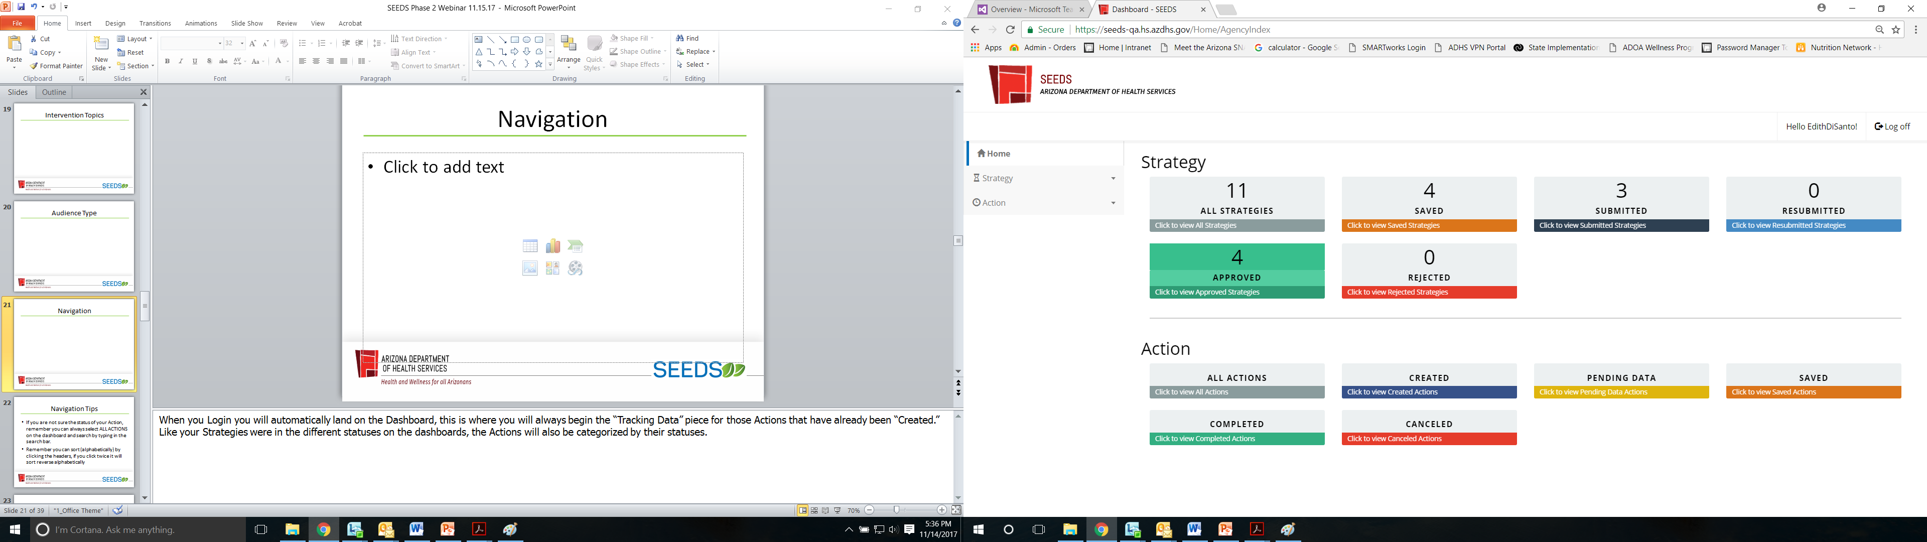
Navigation
Notes:
When you Login you will automatically land on the Dashboard, this is where you will always begin the “Tracking Data” piece for those Actions that have already been “Created.” Like your Strategies were in the different statuses on the dashboards, the Actions will also be categorized by their statuses.

Slide 32
Navigation Tips
If you are not sure the status of your Action, remember you can always select ALL ACTIONS on the dashboard and search by typing in the search bar.
Remember you can sort (alphabetically) by clicking the headers, if you click twice it will sort reverse alphabetically

Slide 33
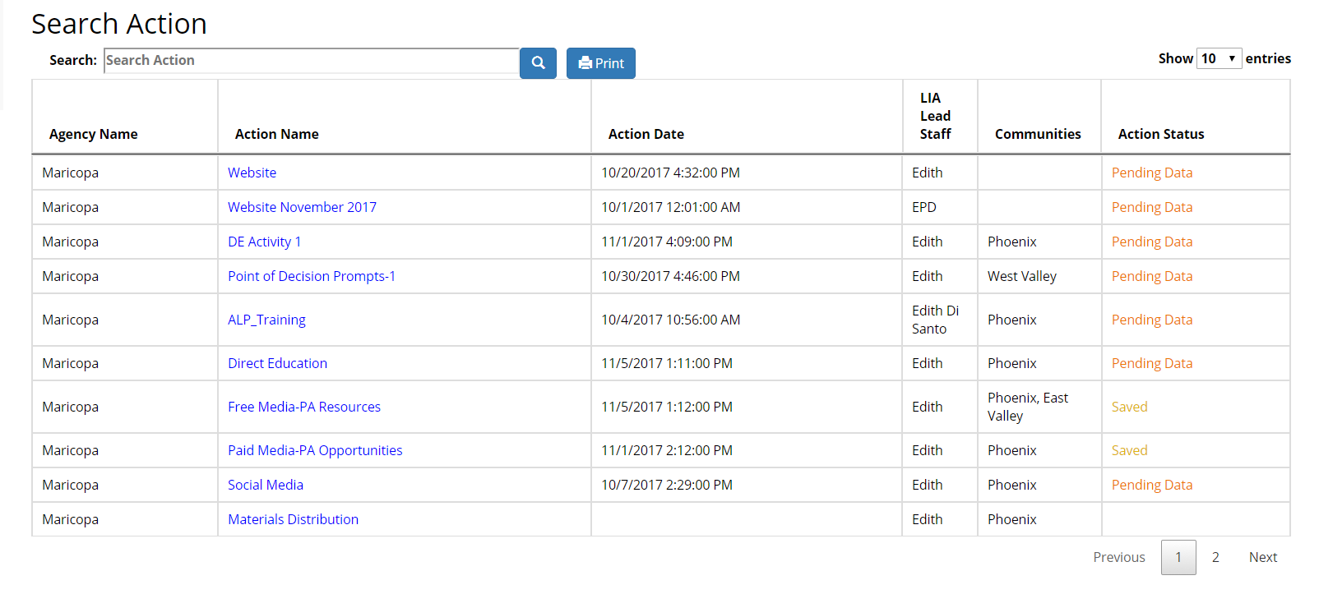
All Actions Search

Slide 34
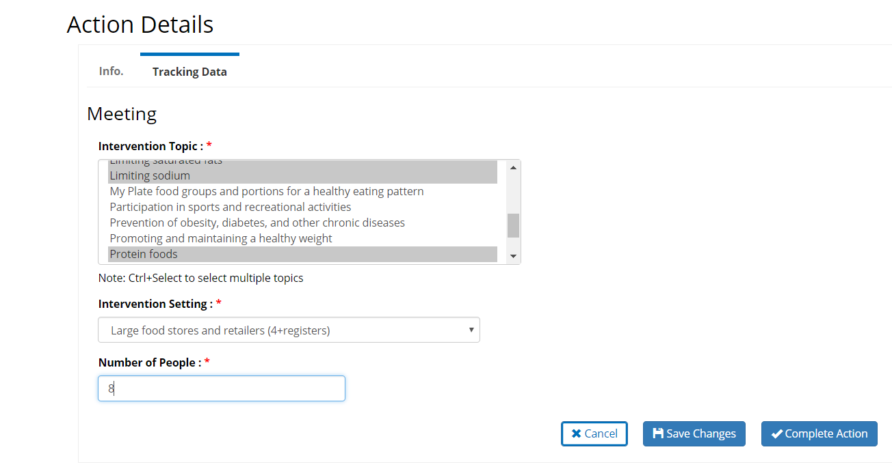
Tracking Data- Meeting

Slide 35
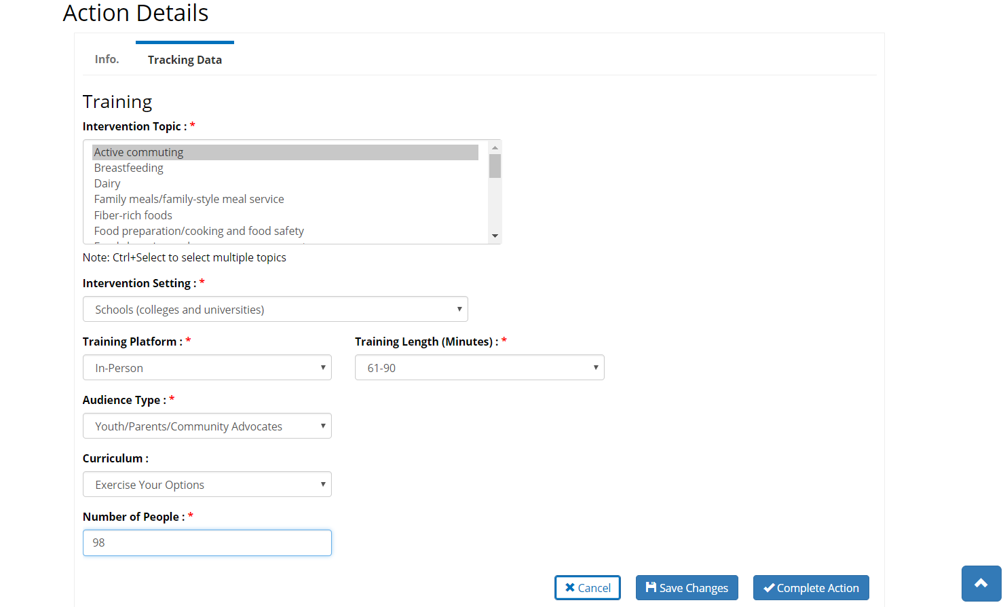
Tracking Data-Training

Slide 36
Tracking Data-Assessment
This screen is not enabled during initial deployment of Phase 2 (Release 1), it will be deployed in Release 2 of Phase 2.
Please note: if there is a date entered, then the system will change the status of your action from “Created” to “Pending Data” although you are not able to enter data at this time.

Slide 37
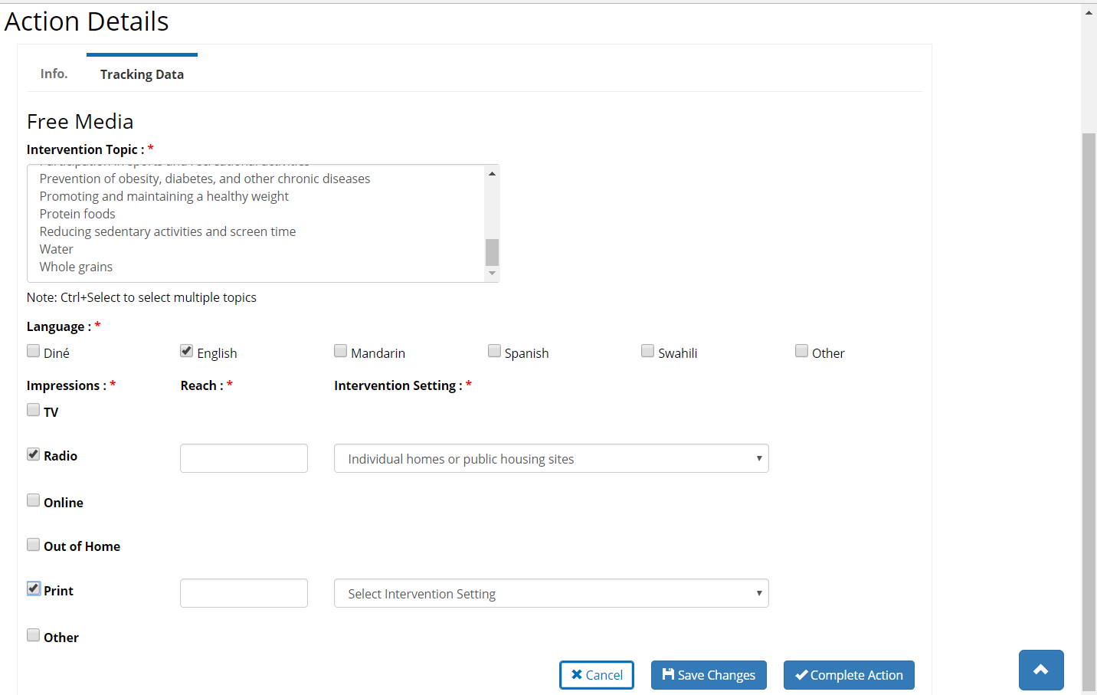
Tracking Data-Free Media

Slide 38
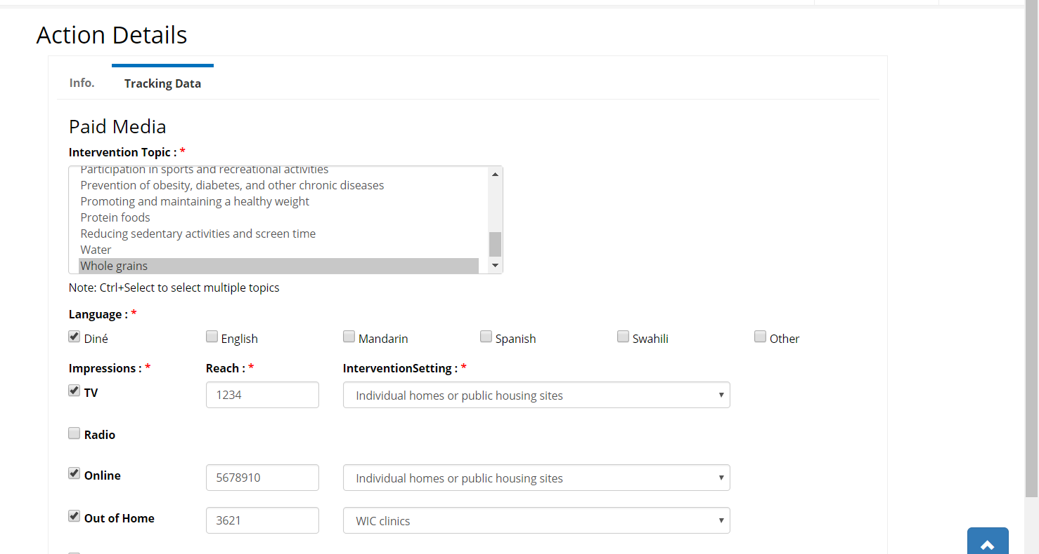
Tracking Data-Paid Media

Slide 39
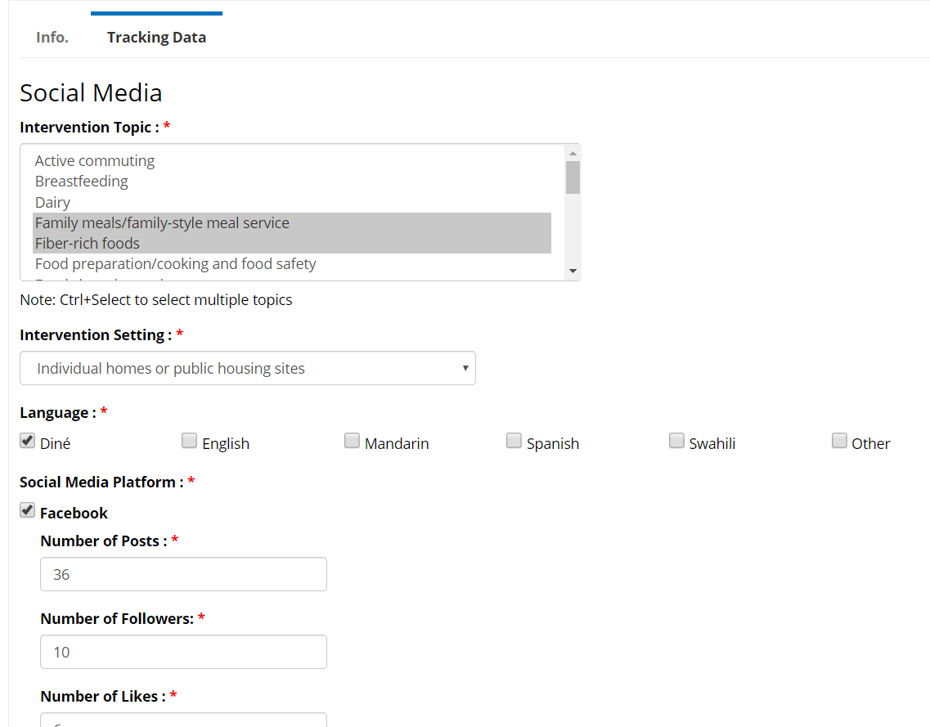
Tracking Data-Social Media

Slide 40
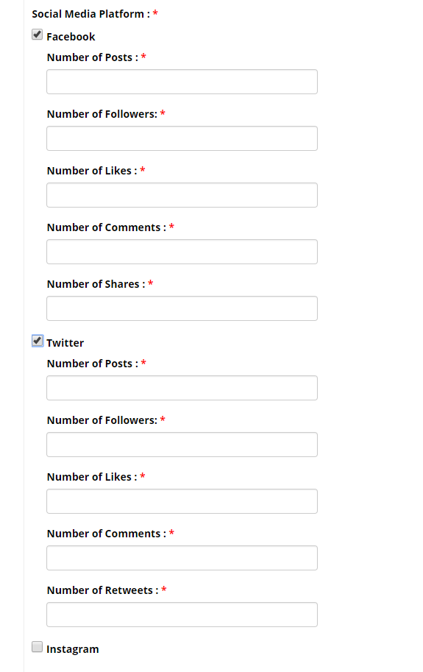
Social Media Cont.

Slide 41
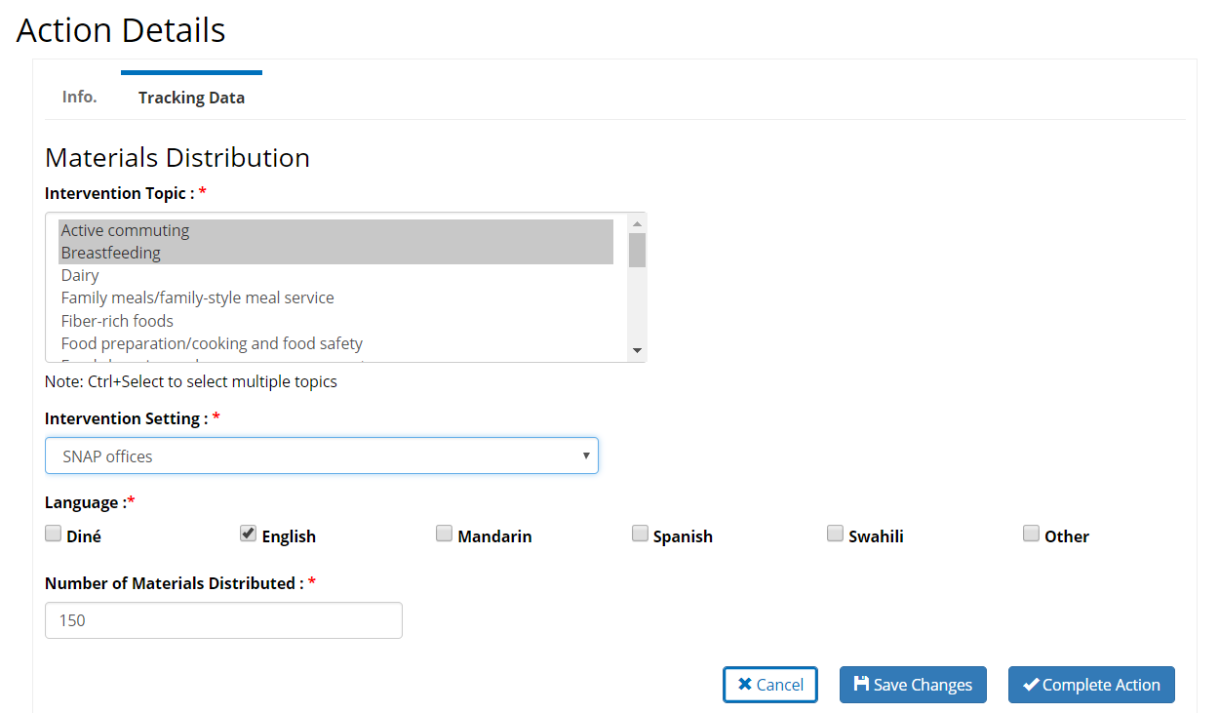
Tracking Data-Materials Distribution
Notes:
Show them?

Slide 42
Tracking Data-Point of Decision Prompts

Slide 43
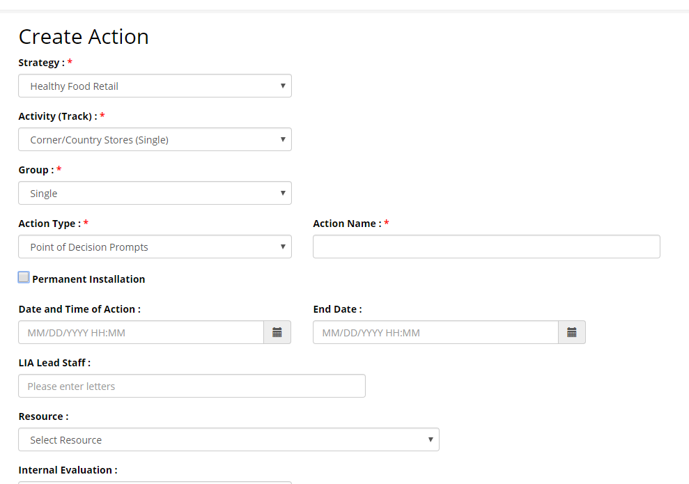
Permanent Point of Decision Prompts

Slide 44
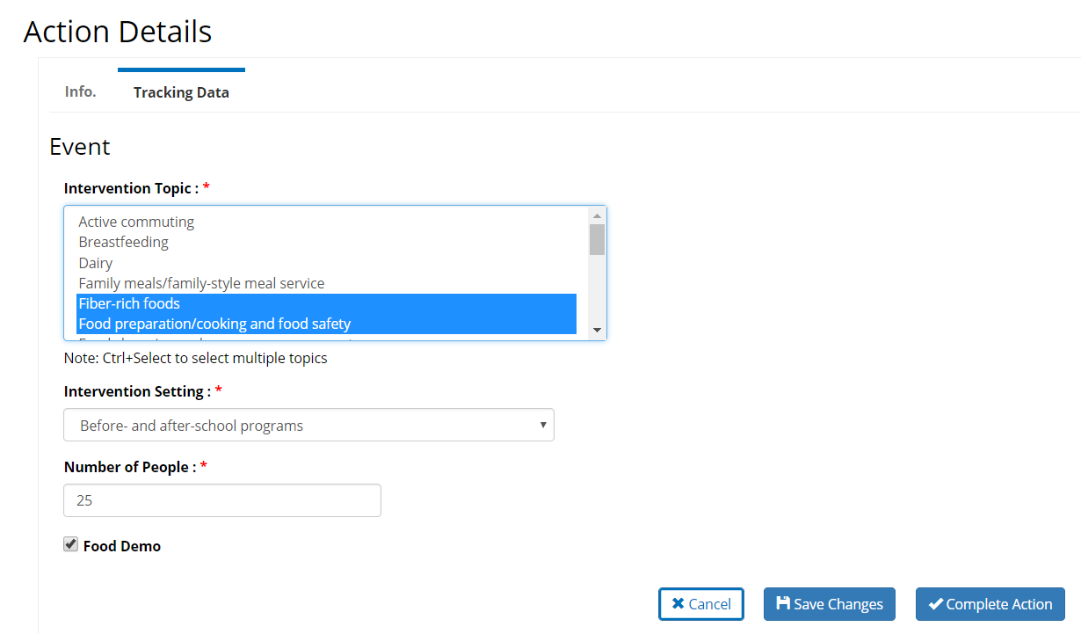
Tracking Data-Event

Slide 45
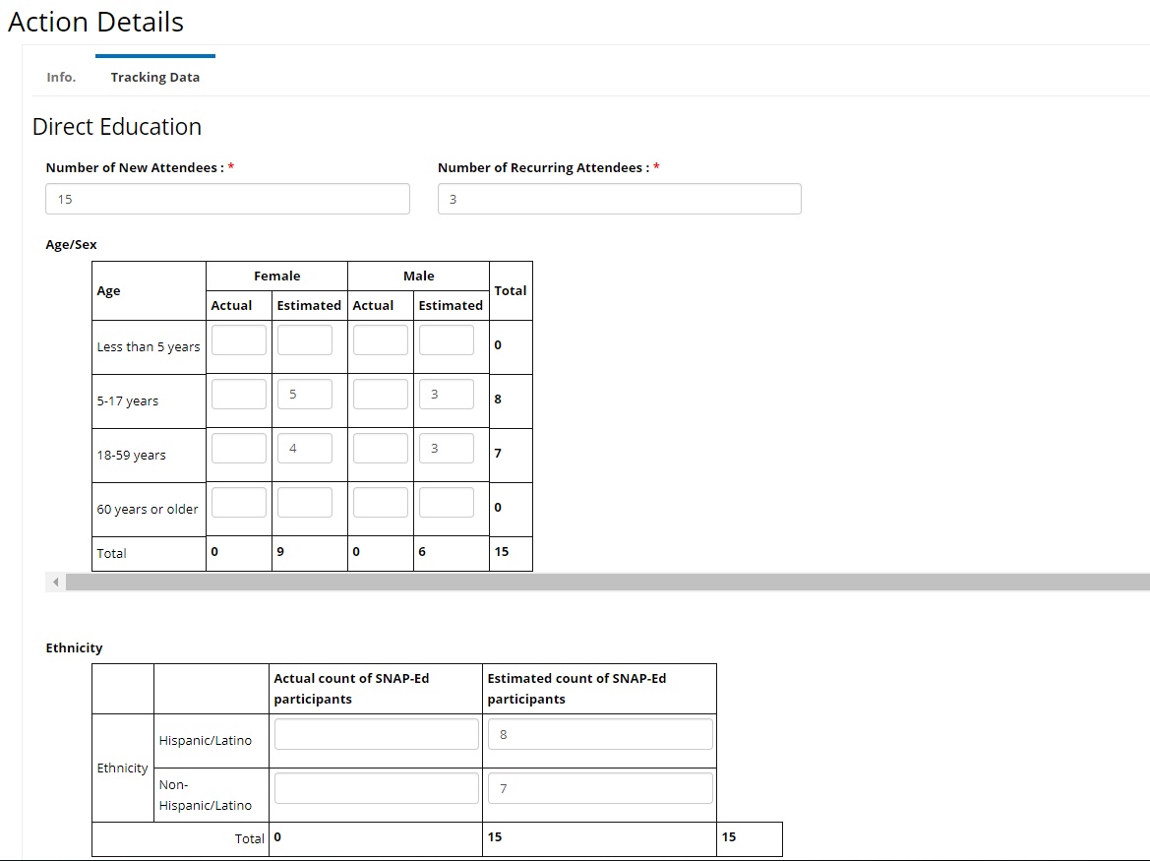
Tracking Data-Direct Education

Slide 46
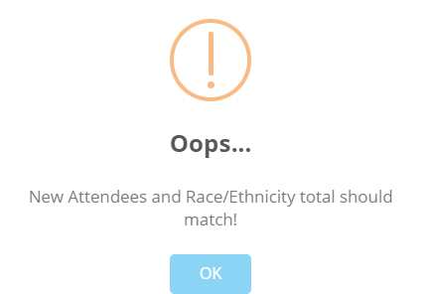

Example of Calculation Error-DE

Slide 47
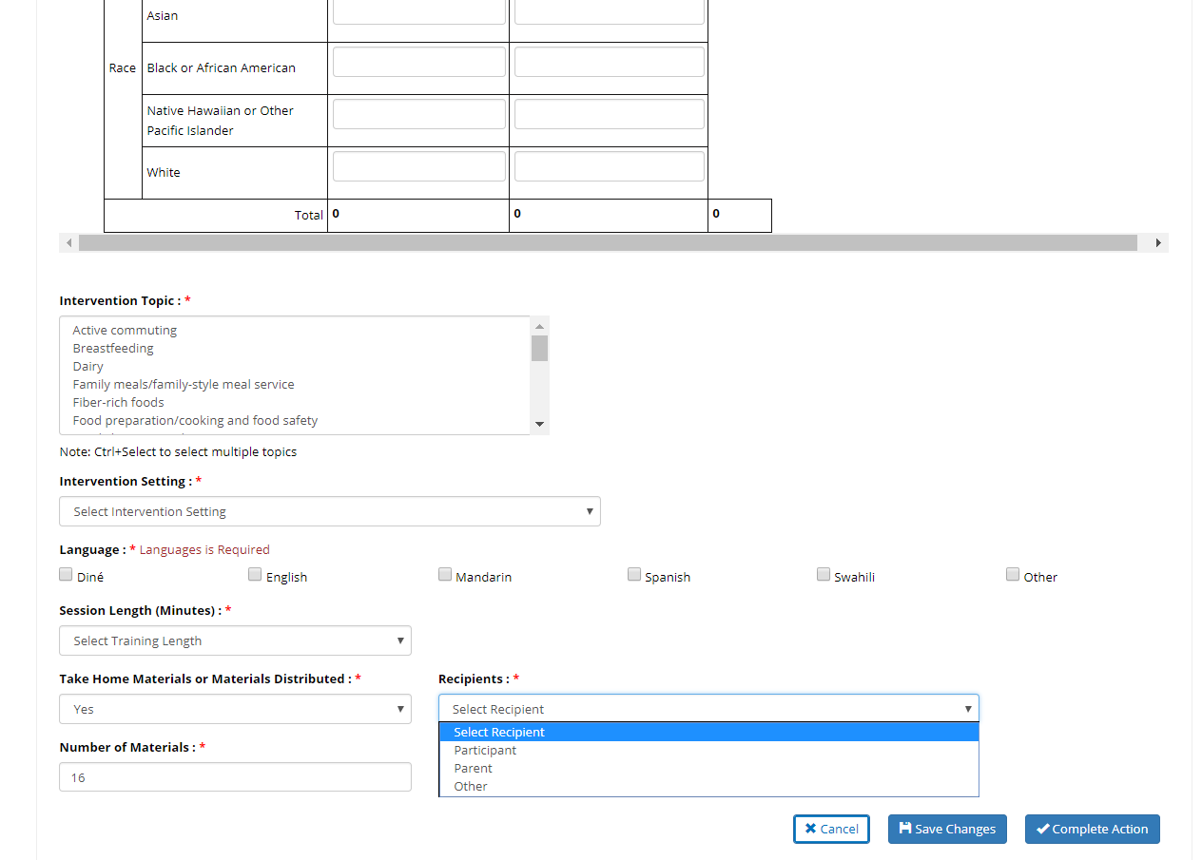
Tracking Data-Direct Education

Slide 48
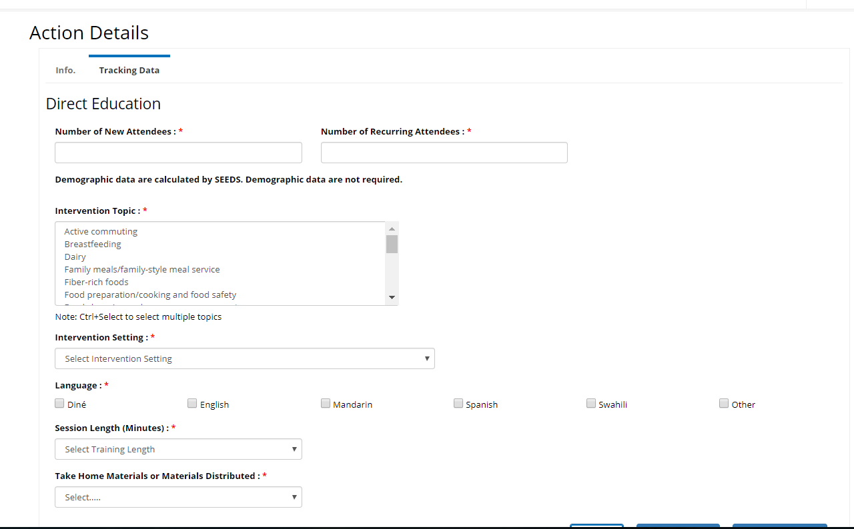
Tracking Data-Direct Education
Calculated
Notes:
NEED Specifics of when this will happen.

Slide 49
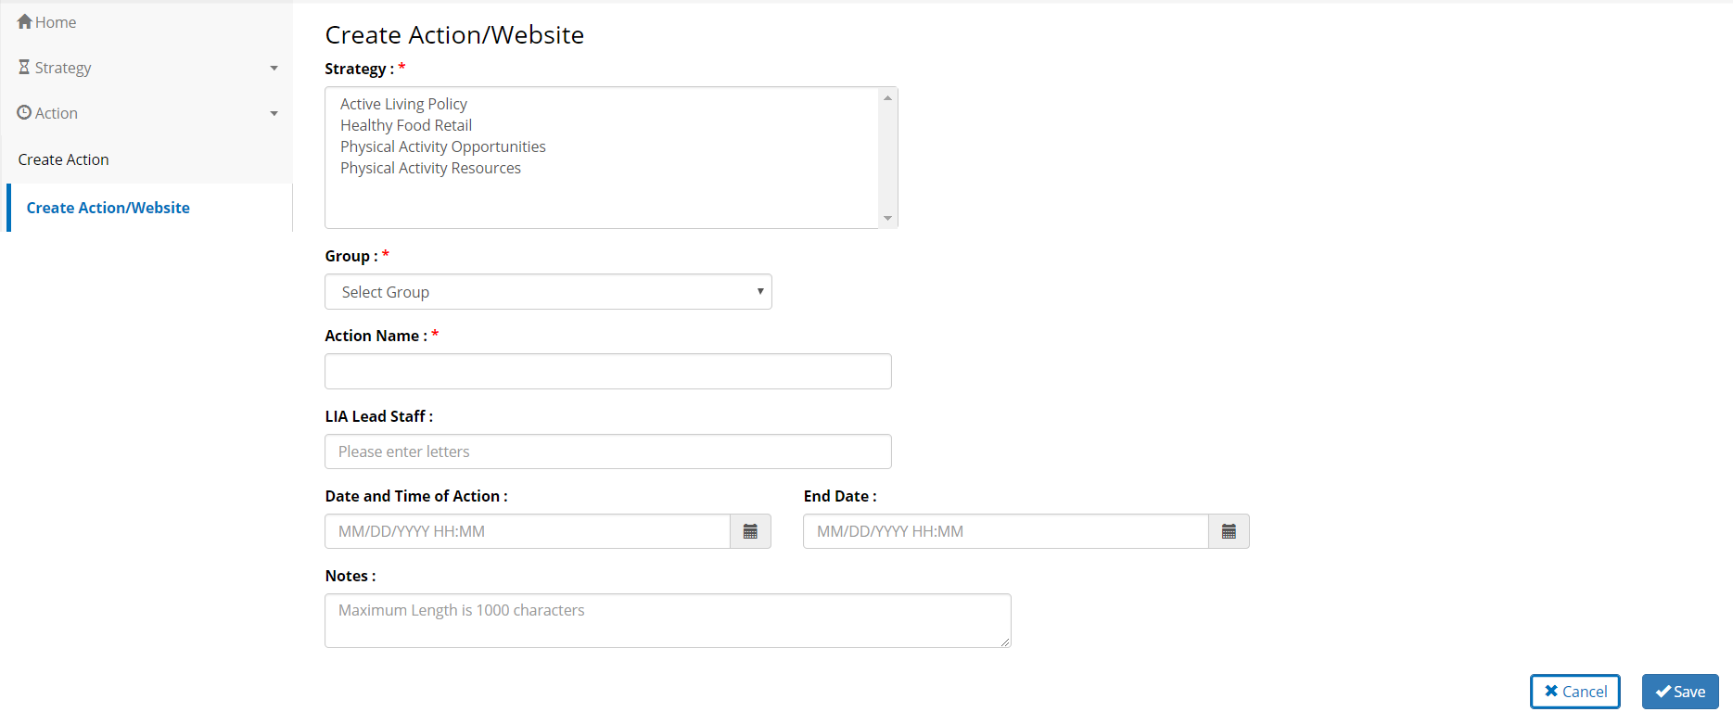
Create Action/Website
Notes:
Exactly the same as Create Action, but allows for you to tie to multiple strategies.

Slide 50
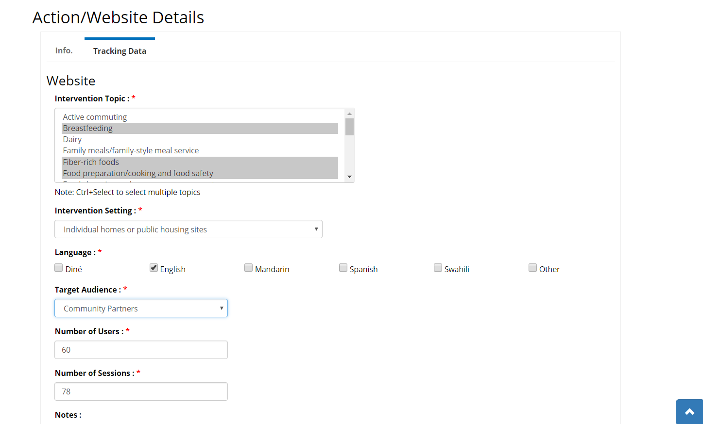
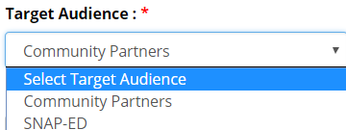
Tracking Data-Website

Slide 51

Questions???

Slide 52
Next Steps & Timeline
Phase 2 Release 2 is expected February 2018.
Phase 2 Release 2 will expand on Tracking Data and will begin the reporting functions.

Slide 53
In-Person Training:
Same training two date offerings:
1) Tuesday, November 21, 2017 9am -12pm Tempe, Arizona
2) Wednesday, November 29, 2017 11am-2pm Tempe, Arizona
Registration will close END of day Nov. 15th!

Slide 54
SEEDS Email List
Sign up via: https://www.surveymonkey.com/r/SEEDSemails
We will be sending updates, FAQs and tip sheets regularly

Slide 55
Questions
Please feel free to reach out to us with any questions.
For SEEDS specific information: contact Edith Di Santo:, edith.disanto@azdhs.gov

